Slide 1
Offline Room or Cottage Reservation System for Mocking Jay Pool Resort
Using vb.net and Ms Access

Slide 2
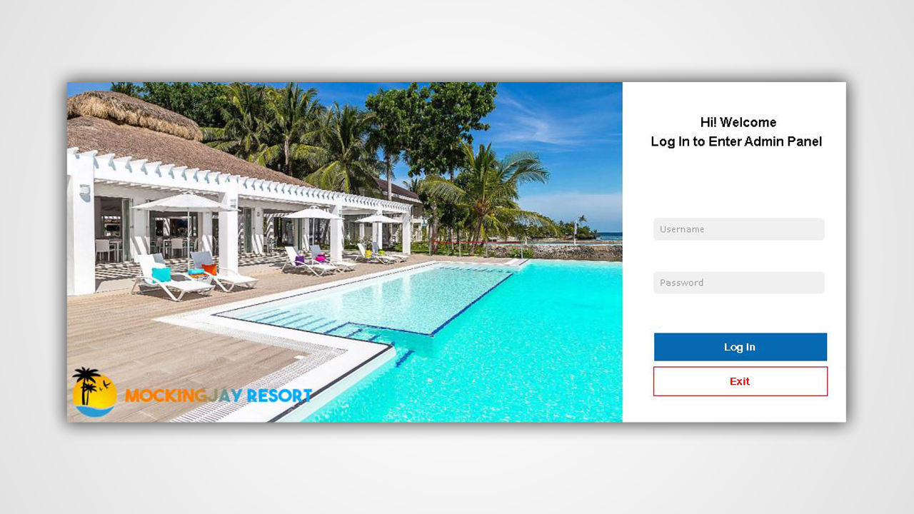
LOG IN UI

Slide 3
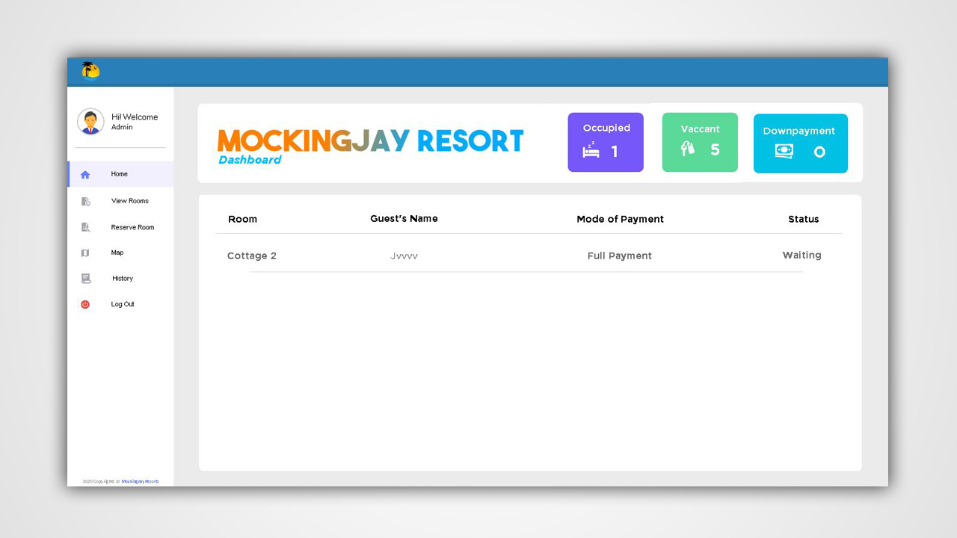
ADMIN PROFILE UI - DASHBOARD

Slide 4
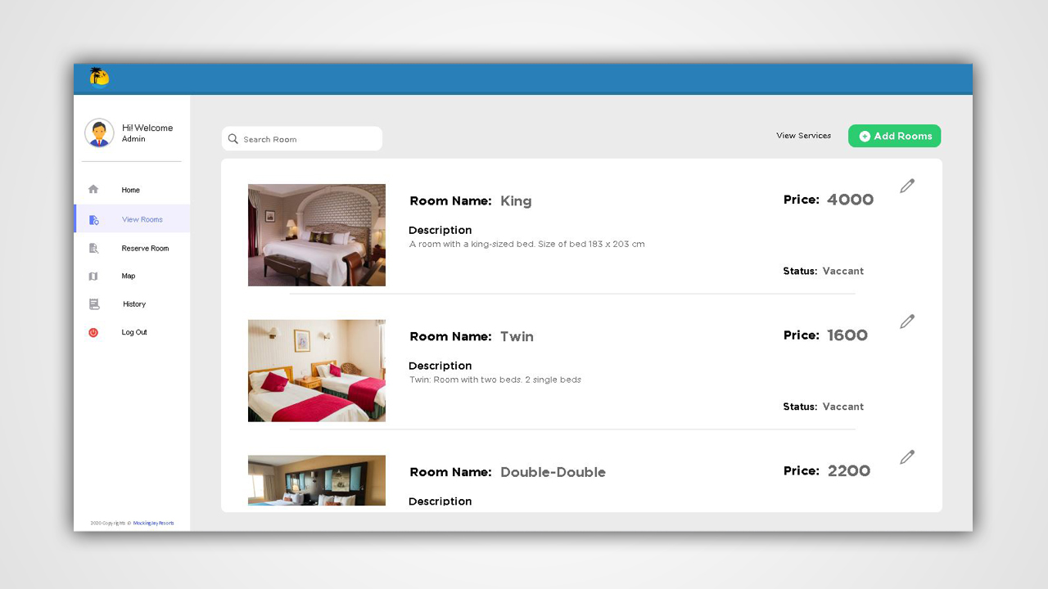
ADMIN PROFILE UI - ROOMS

Slide 5
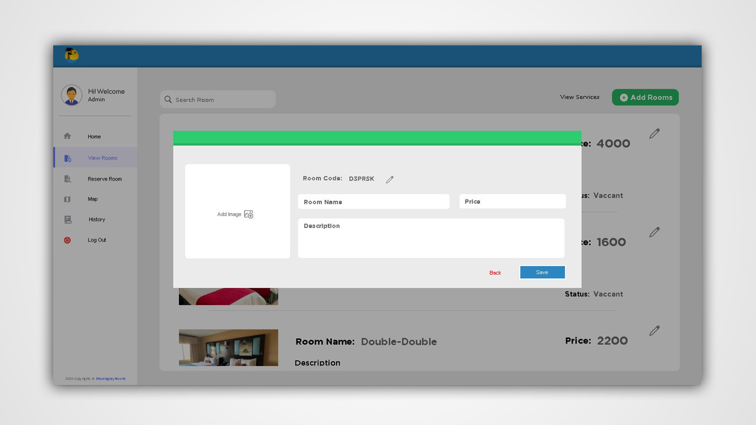
ADMIN PROFILE UI - ROOMS

Slide 6
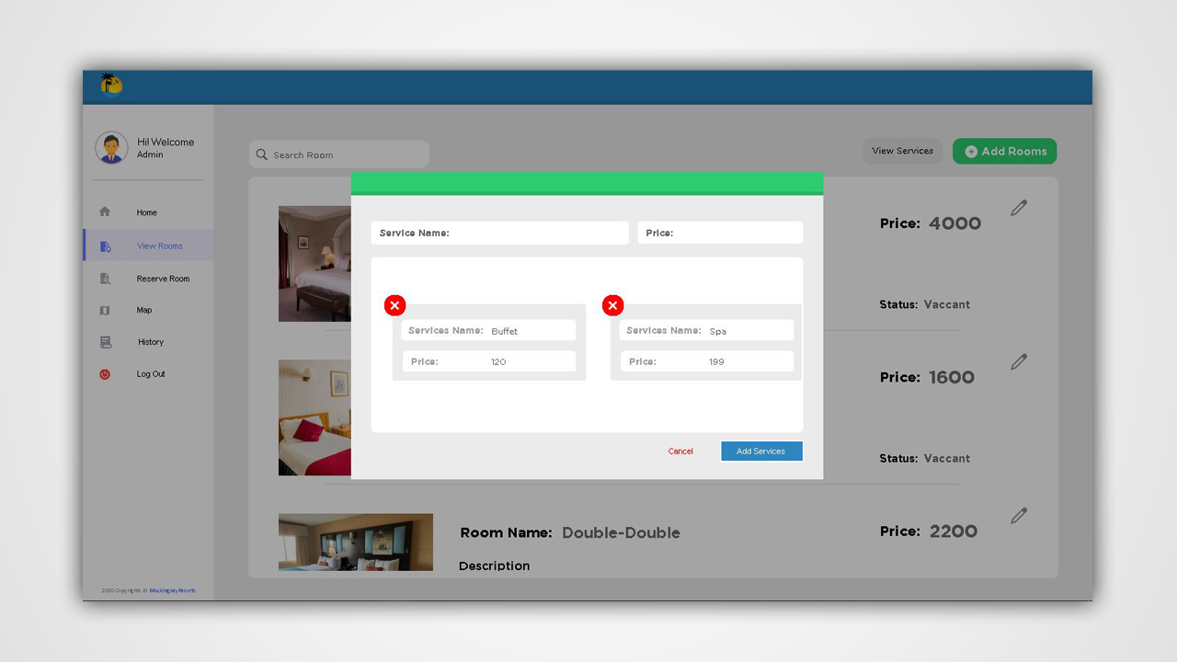
ADMIN PROFILE UI - ROOMS

Slide 7
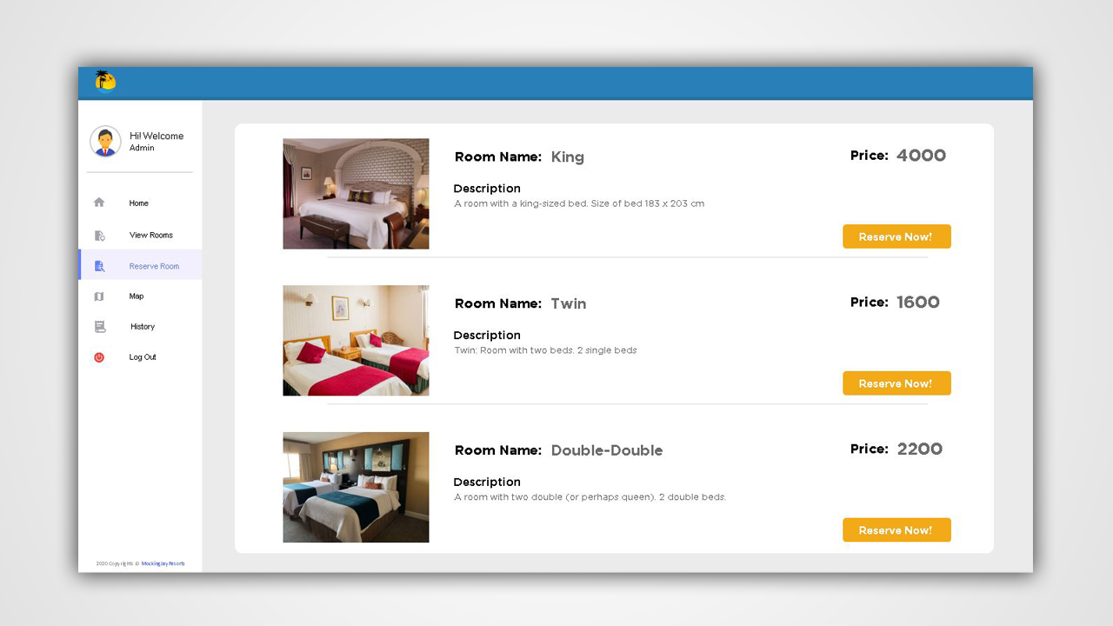
ADMIN PROFILE UI - RESERVATION

Slide 8
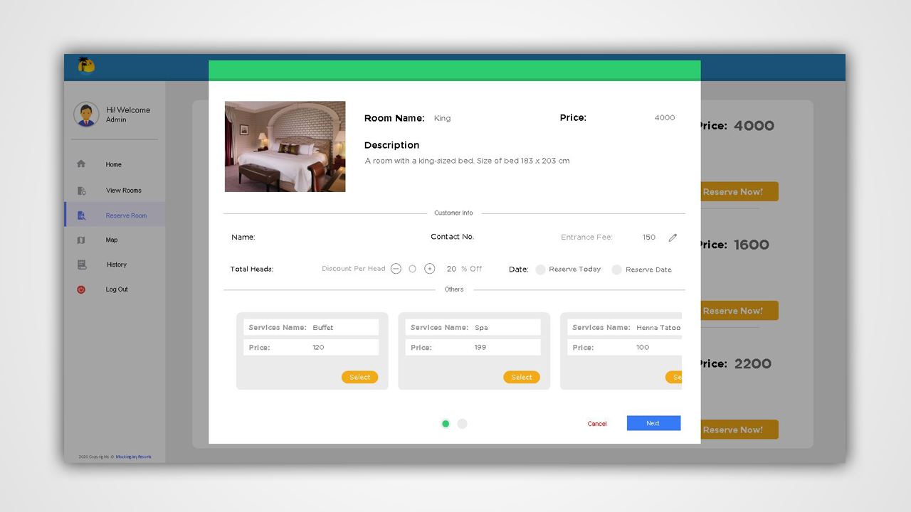
ADMIN PROFILE UI - RESERVATION

Slide 9
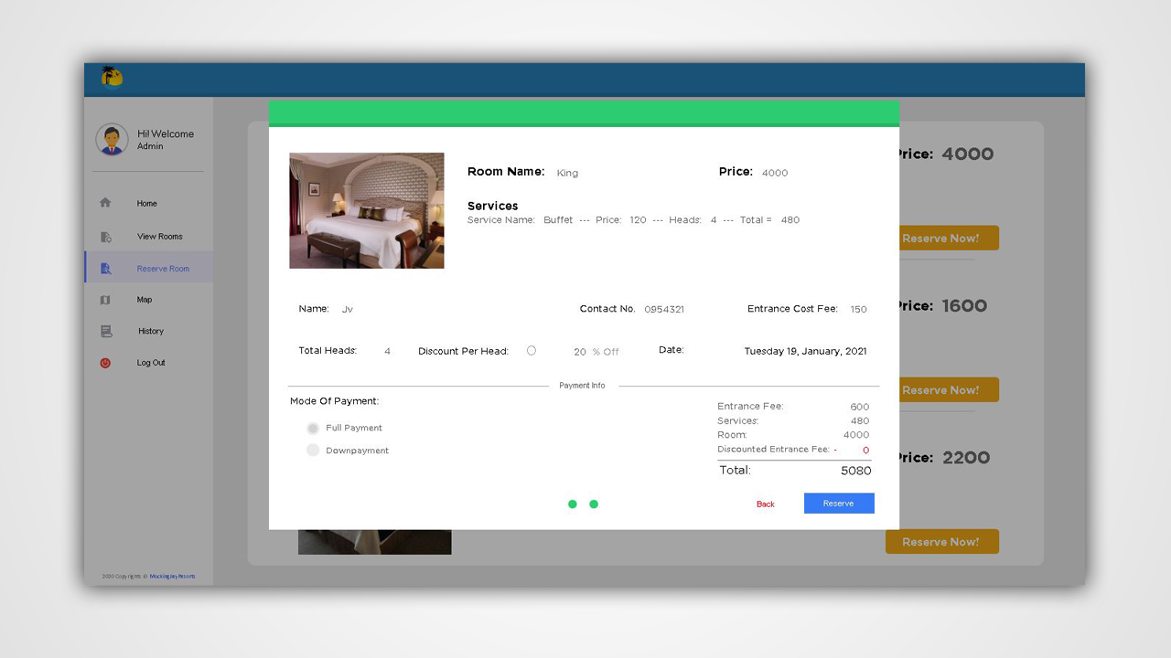
ADMIN PROFILE UI - RESERVATION

Slide 10
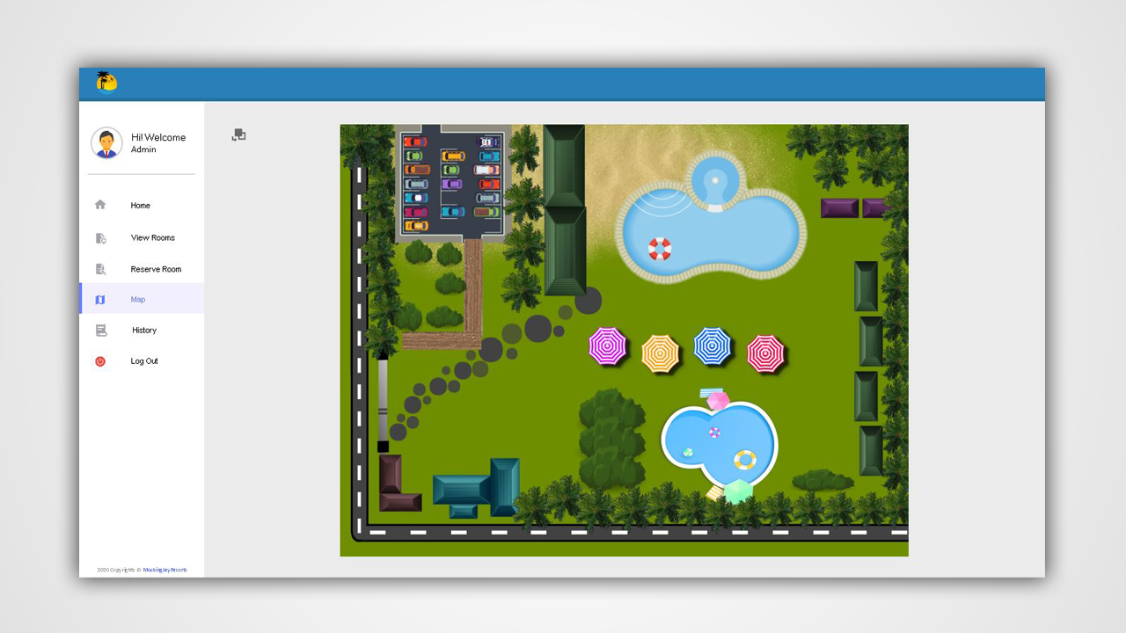
ADMIN PROFILE UI - MAPS

Slide 11
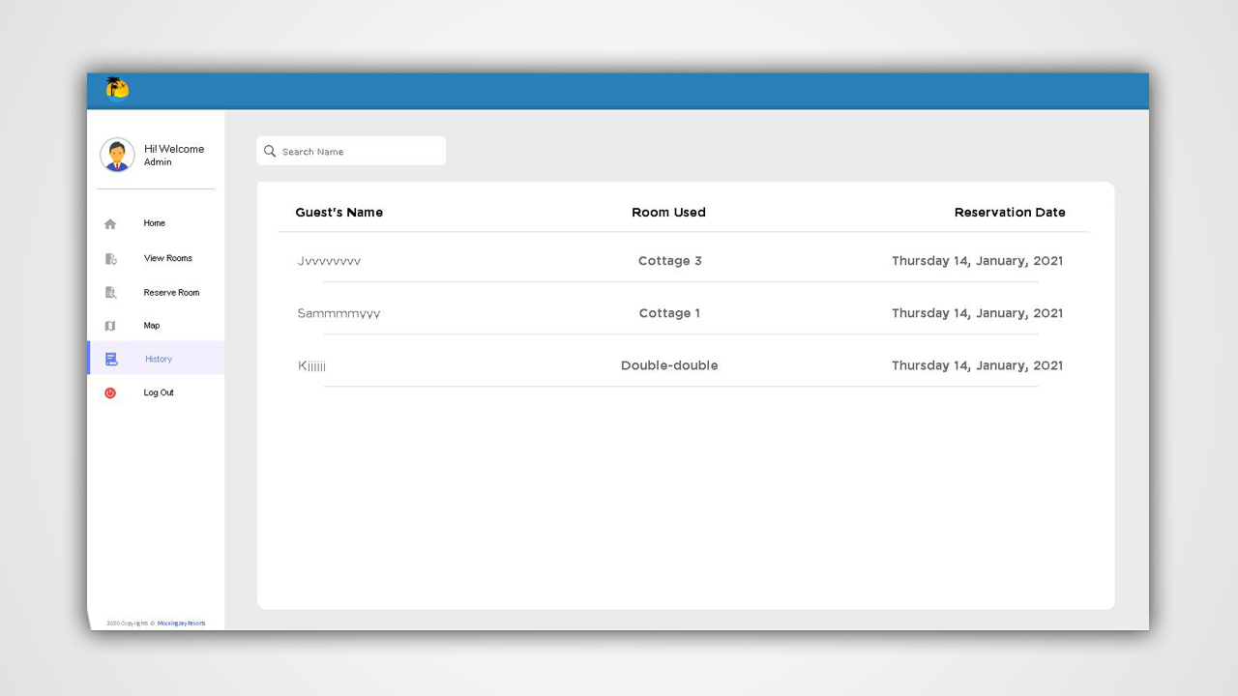
ADMIN PROFILE UI - HISTORY

Slide 12
THANK YOU

